Slide 1
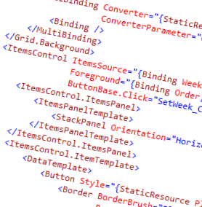
WPF and XAML
3 – Basic XAML Controls, Events and Commands

Slide 2
Overview
XAML Hierarchy
Common controls

Slide 3
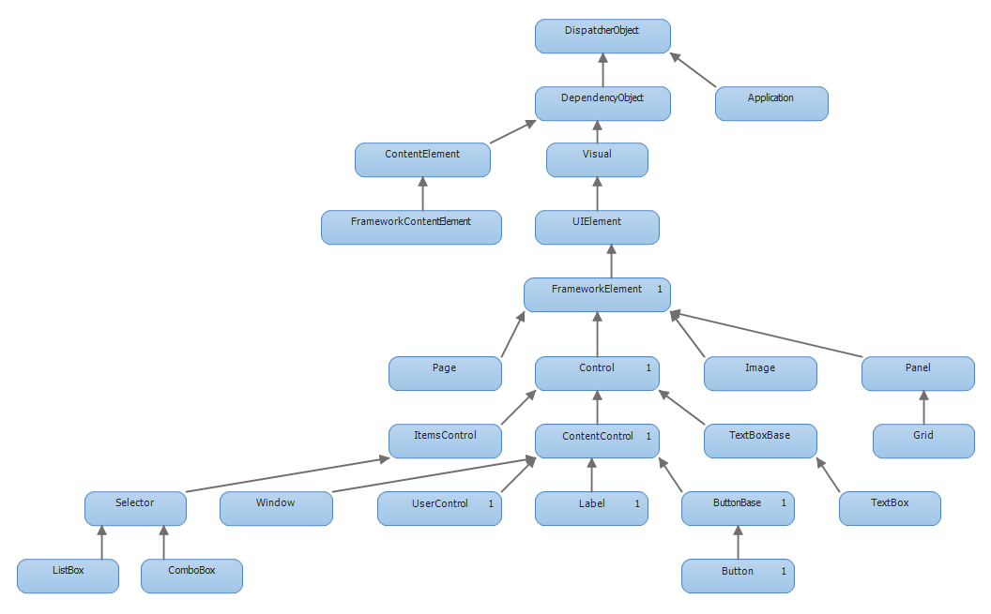
The Hierarchy in a Nutshell

Slide 4
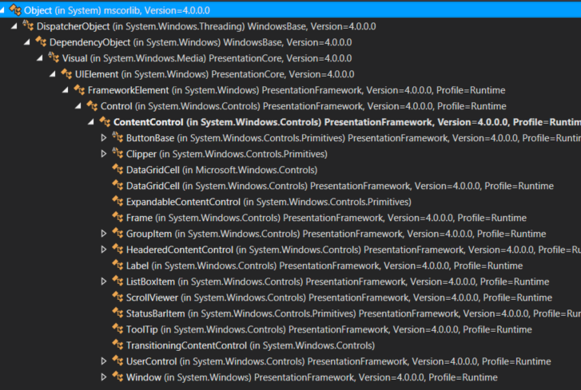
The Important Hierarchy

Slide 5
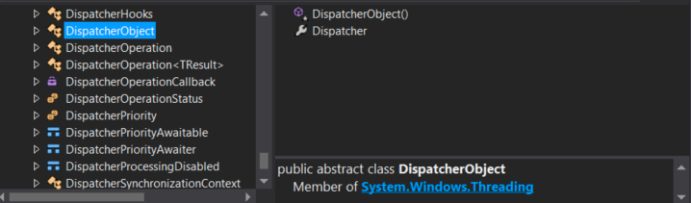
Core Type: DispatcherObject
Provides synchronization of messages to the UI thread
May become your best friend

Slide 6
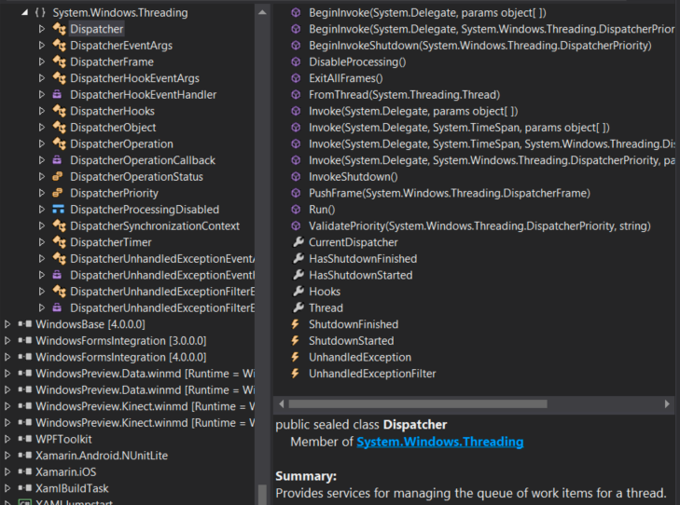
The Dispatcher
All XAML UI controls run on one thread
Requests to their methods are sync’d through the dispatcher
Thread based affinity
Queue of Actions to be run on the thread of the Dispatcher

Slide 7
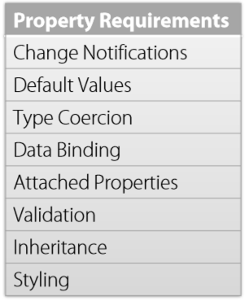
Core types: DependencyObject
More advanced properties than CLR properties
A DependencyObject can have DependencyProperties
Participates in data binding with dependency graphs

Slide 8
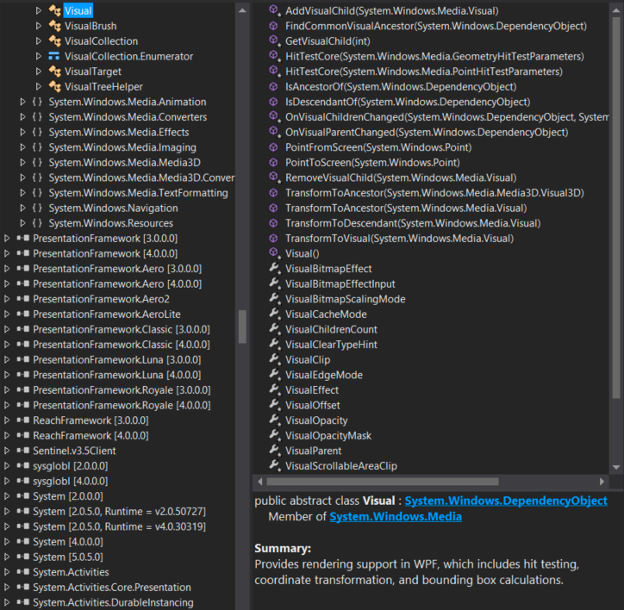
Visual
Provides rendering support in WPF, which includes hit testing, coordinate transformation, and bounding box calculations.

Slide 9
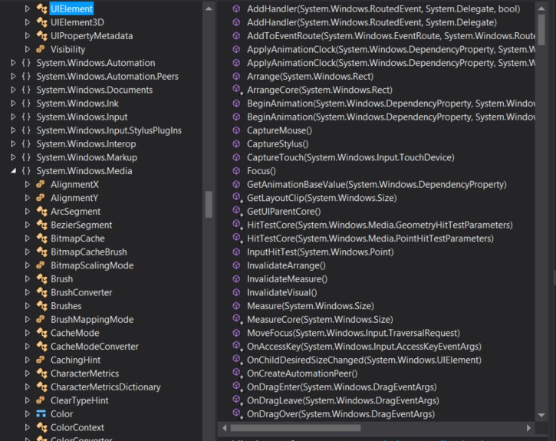
UIElement
a base class for WPF core level implementations building on Windows Presentation Foundation (WPF) elements and basic presentation characteristics.

Slide 10
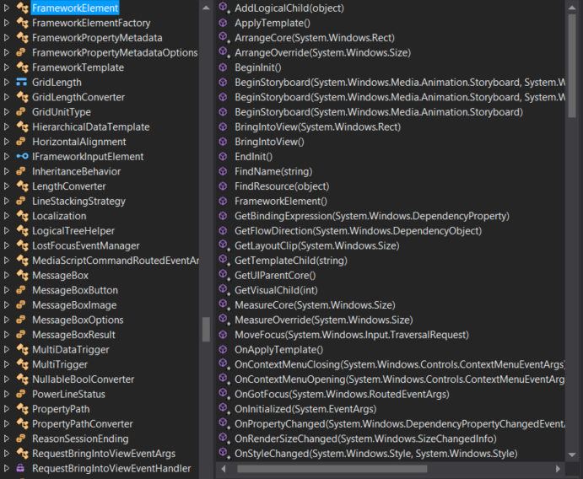
FrameworkElement
Participates in layout
Height, Width, Alignment
Perhaps most importantly: DataContext

Slide 11
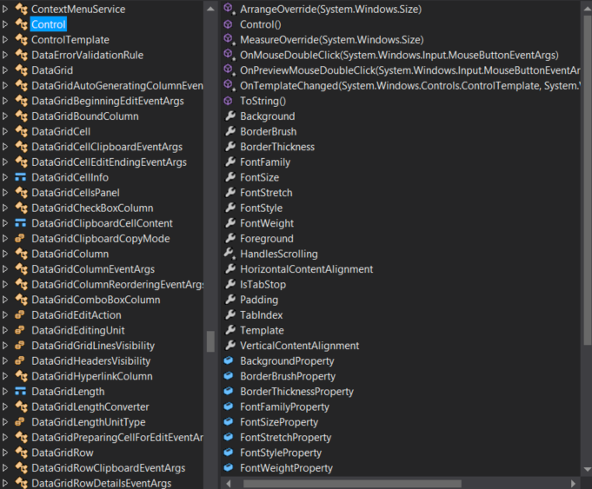
Control
Provides ControlTemplate functionality
The ability to swap out visual representation

Slide 12
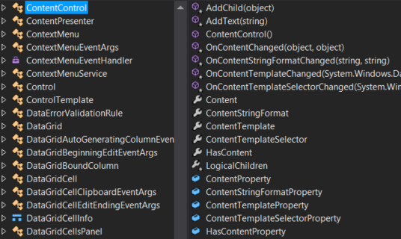
ContentControl
Represents a control with a single piece of content of any type

Slide 13
Common Elements
Buttons
Text and input
Range controls
Item controls

Slide 14
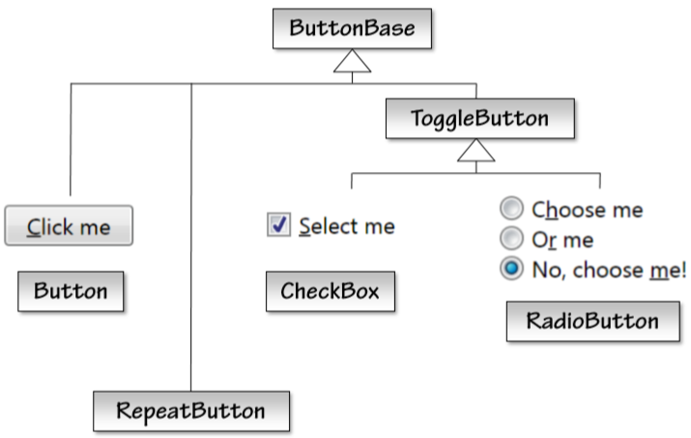
Buttons

Slide 15
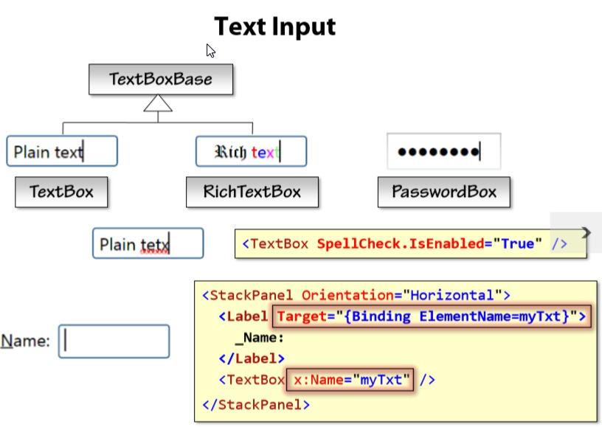
Text and Input

Slide 16
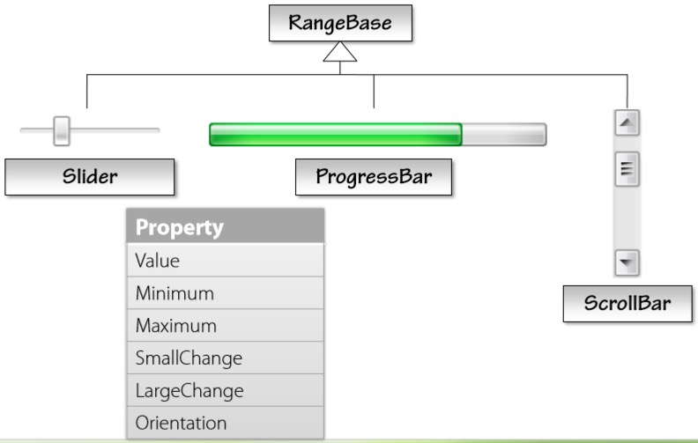
Range Controls

Slide 17
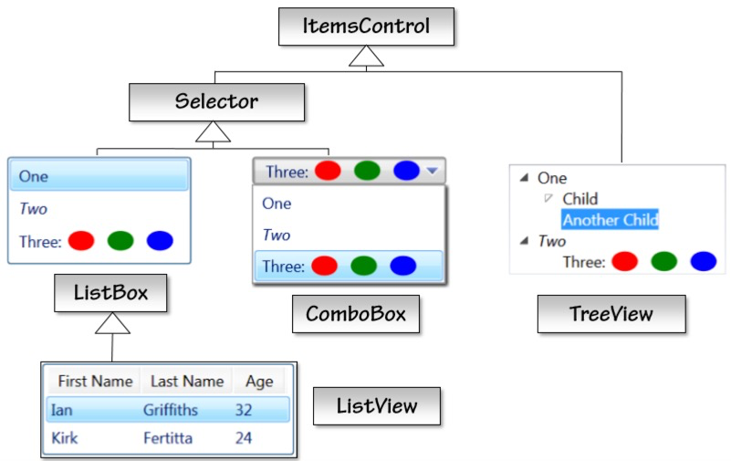
Item(s) Controls

Slide 18
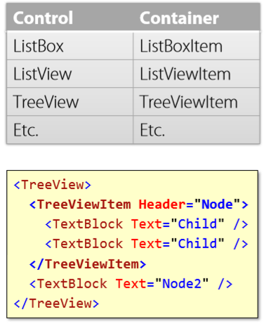
Item Containers

Slide 19
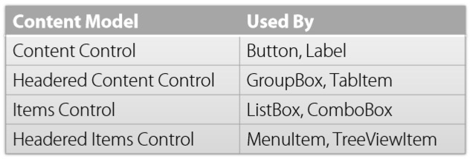
Content Models

Slide 20
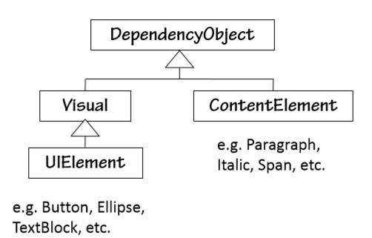
Controls vs Elements
Controls imply behavior
Appearance is replaceable
Not all elements are controls
TextBlock, Image, Border, Ellipse

Slide 21
Events and Commands
Events
Low-level: mouse, keyboard input, …
Commands
Higher: menus, buttons, gestures

Slide 22







Interaction: Routed Events

Slide 23







Routed Events
Button
Image in Button

Slide 24


What happens in a button click?
PreviewMouseDown

Slide 25
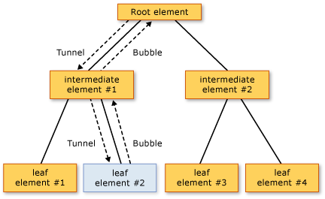
Event routing
Tunneling (previews)
Bubbling
Direct (mouse enter)

Slide 26
Commands
Provide a separation of invocation and execution of logic
Many elements have a Command property that can specify a command to be used on a common action (click for a button)
We will see more on them in the MVVM module

Slide 27
Summary
Looked at the hierarchy of XAML objects
Examined a few common XAML controls
Discussed the routed event model

Slide 28
Demo
Demonstration of common controls
Event handling

